Slide 1

BRACT’s Vishwakarma Institute of Information Technology Department of Engineering and Applied Sciences
Cloud Computing and DevOps
CI/CD Pipeline using GitHub Actions & S3 Bucket
Academic year: 2022 - 23 Semester: 6th Batch: C3
Roll No. | PRN No. | Name of Student
323071 | 22120149 | Om Butala
323072 | 22120150 | Anirudha Kurhade
323075 | 22120161 | Jidnyasa Sonavane
323070 | 22120147 | Gaurav Lonari

Slide 2
We are deploying a react app to AWS using S3 Bucket static website hosting and github actions to build and deploy the app to Bucket

Slide 3

Method
Create a new IAM user with access to Access Keys and S3 Bucket
Create a new S3 Bucket and enable public access and static website hosting
Create a new Build.yml file in repository for github actions configuration
Upload the project code to GitHub repository with build.yml
Once the build is pushed to repository, the github action set in build.yml will trigger and code will be built and deployed to AWS S3

Slide 4
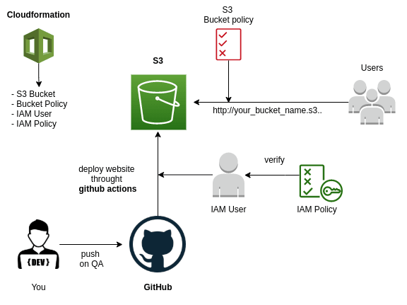
CI/CD Pipeline
npm build
aws-action/deploy-to-s3

Slide 5
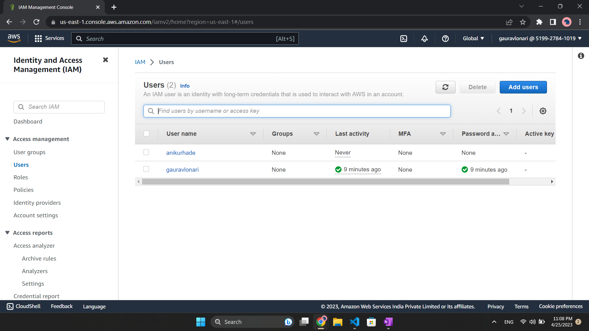
1. Create New IAM User
Open IAM Service in AWS
Add users
Set username
Set Custom Password
Add User

Slide 6
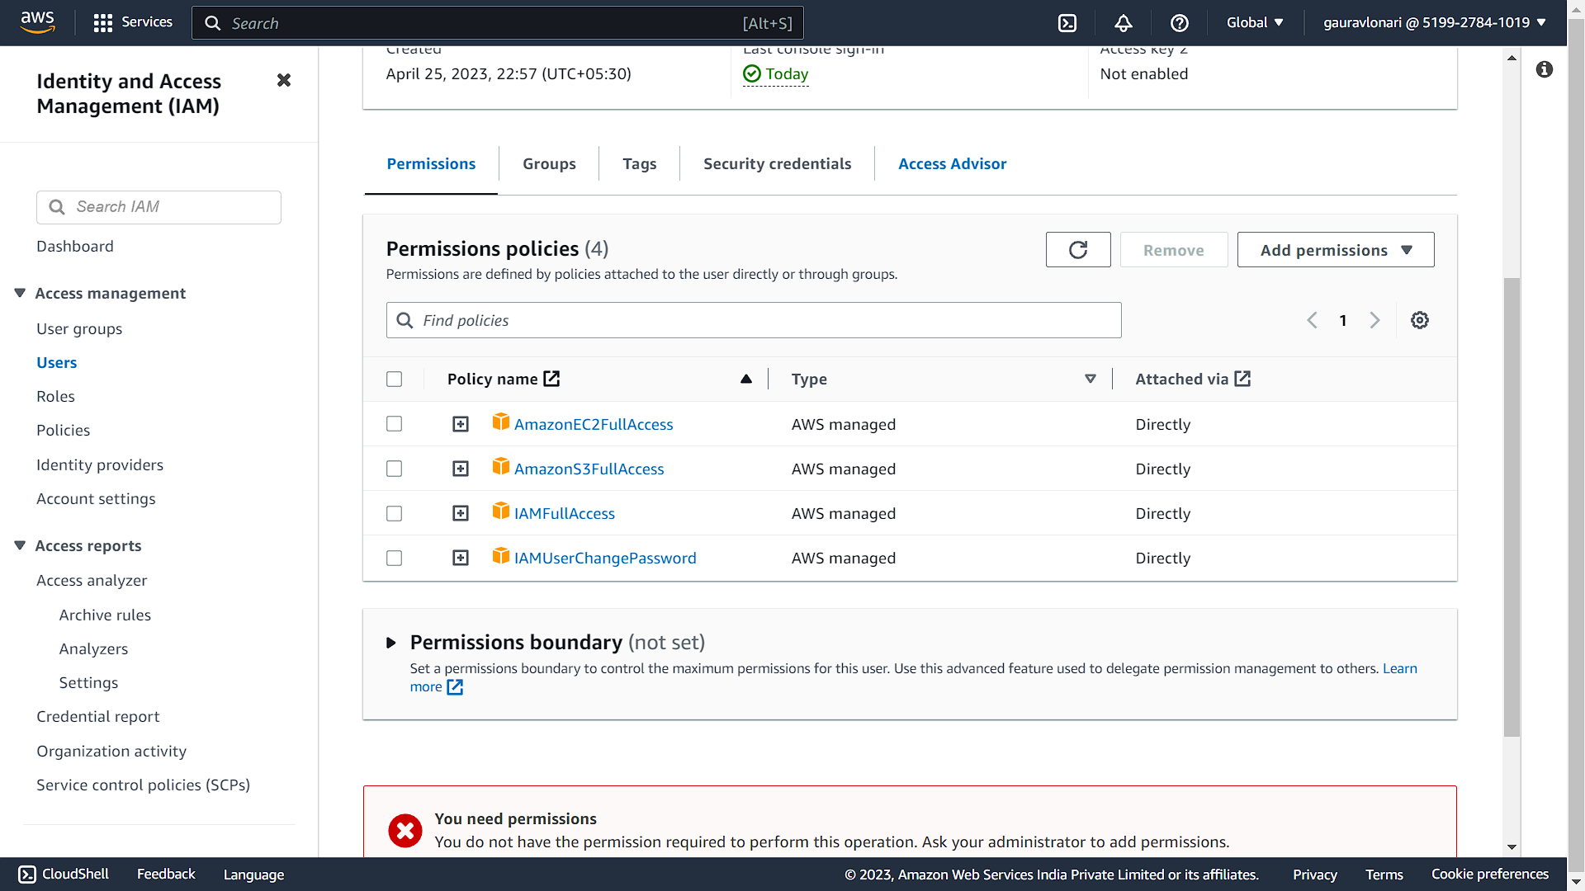
2. Setup Permissions
Click on your username in IAM Users
Add Permissions
Attach Policies directly
Add:
AmazonEC2FullAccess
AmazonS3FullAccess
IAMFullAccess
Click Next
Review and Done

Slide 7
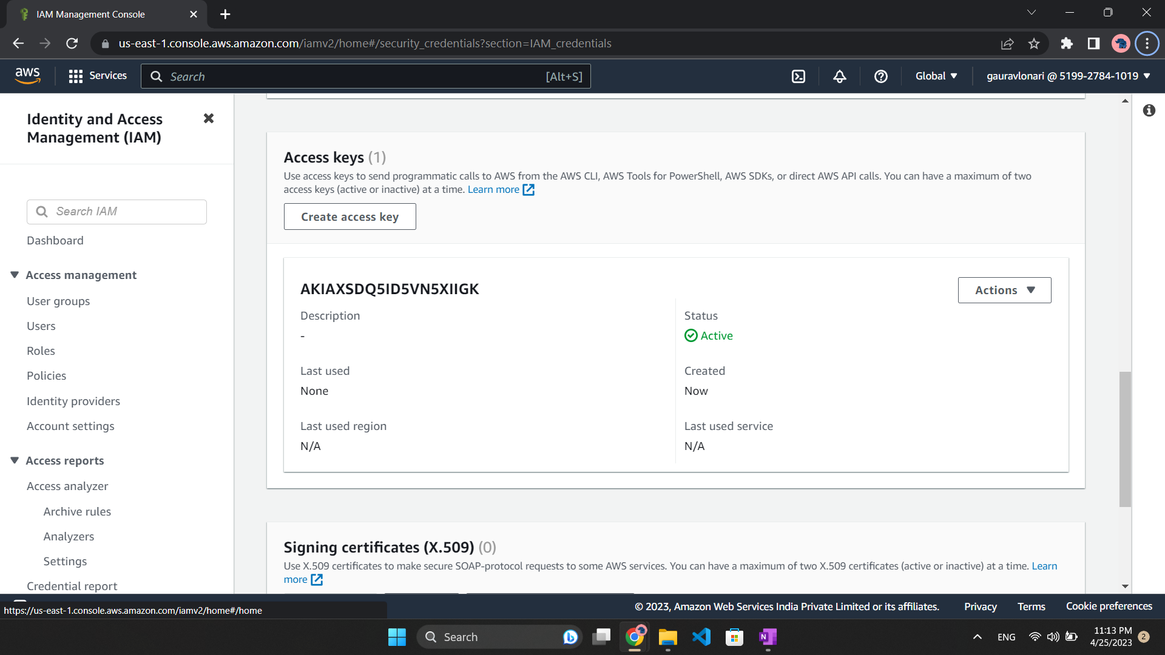
3. Generate Access Keys
In User Details Click on Security credentials tab
In Access Key, create Access Key
Select Other
Copy Both the access key given and paste in some file
Done

Slide 8
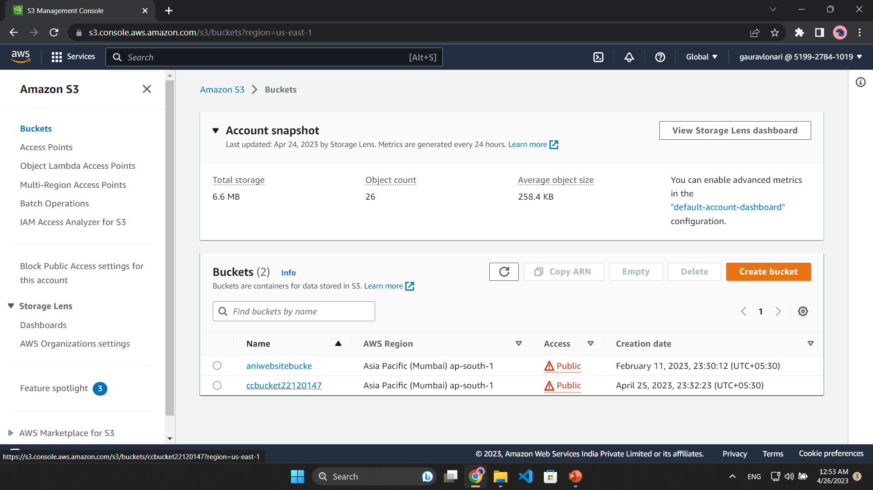
4. Create S3 Bucket
In S3 Bucket Service, click Create Bucket
Give it a unique name (identifier)
Click Create
Done

Slide 9
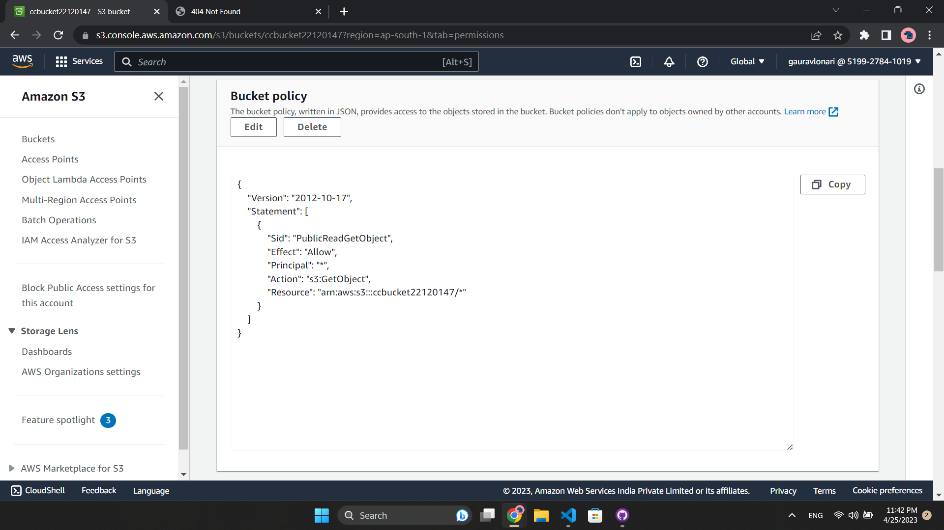
5. Remove all Block Access
In S3 Bucket Service, click on bucket name
Under Properties, click edit in Block Public Access Panel
Untick all checks
Click Save Changes
Edit the Bucket Policy as given in the picture
Done

Slide 10
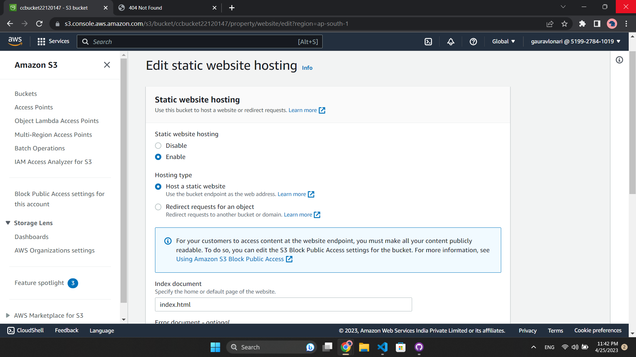
6. Static Website Hosting
In S3 Bucket Service, click on bucket name
Under Properties, click edit in Static Website Hosting Panel
Select Enable
Set Index document as index.html
Click Save Changes
The Public Access URL will be displayed and will be required to visit later.
Done

Slide 11
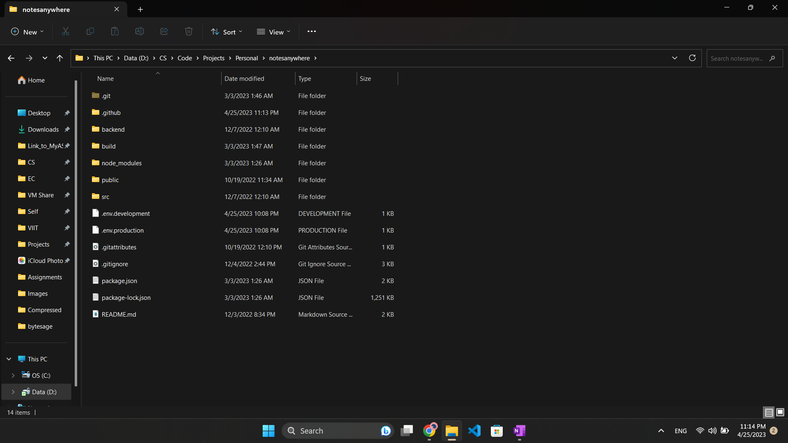
7. Ready your project
Create a GitHub repository and make sure your source code is pushed to GitHub
Done

Slide 12
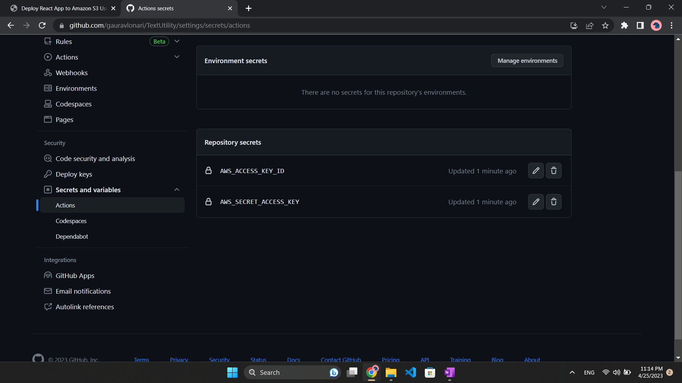
8. Setup Action Secrets
Go to our repo > Settings > Secrets > Actions
Add two repository secrets with name AWS_ACCESS_KEY_ID and AWS_SECRET_ACCESS_KEY.
Provide the credential values to each secrets as copied before.
Done

Slide 13
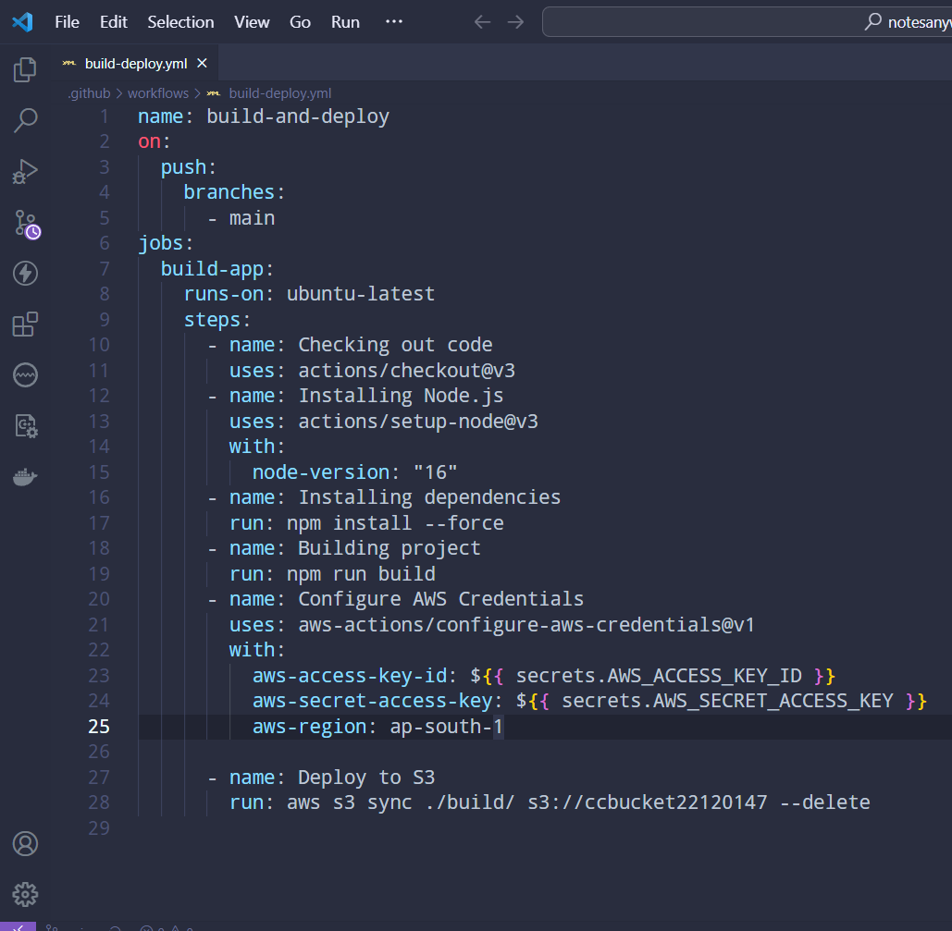
9. Create GitHub Action
- In source code root folder create a new folder structure:
.github/workflows/deploytoaws.yml
- Set the code as displayed in the image in deploytoaws.yml
Run the workflow only when someone pushes code to main branch
Take a VM with latest Ubuntu OS for running the next steps
Checkout the code from main branch
Install Node.js v16 in the VM to enable NPM command
Install project dependencies
Build the project to create /build folder with deployable files
Configure AWS credentials using aws-actions
Upload contents from /build folder to our S3 bucket

Slide 14
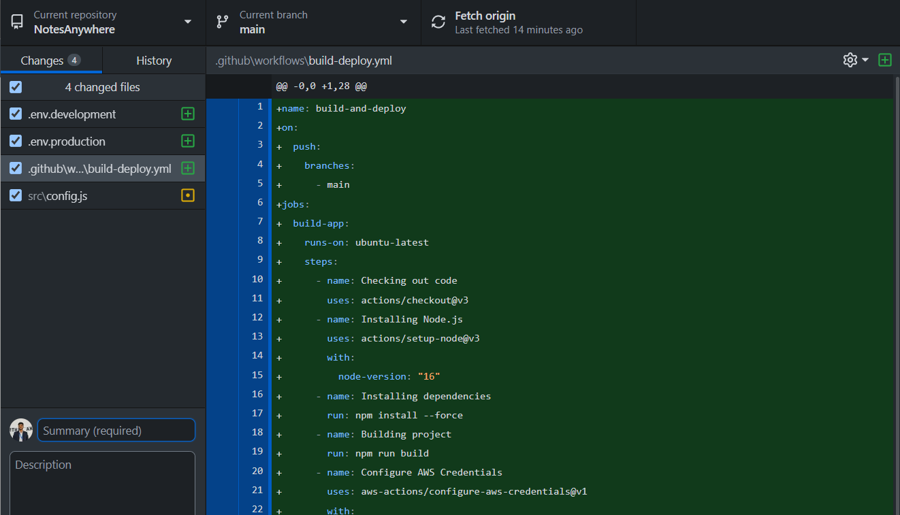
10. Push to Repository
Upload the code again using git terminal or Github Desktop
Done

Slide 15
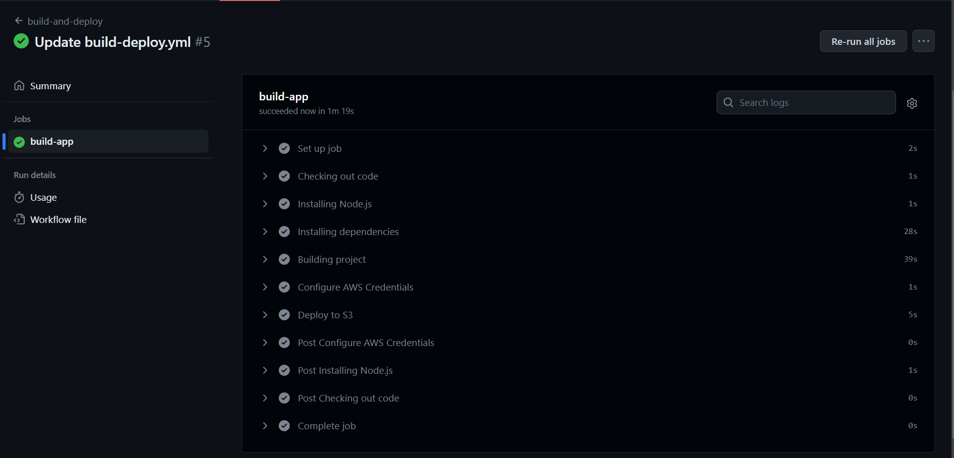
11. Github Action Workflow
Open Actions tab for repository
Here you can verify the action triggered
Under it you can see the action workflow as given in image
Done

Slide 16
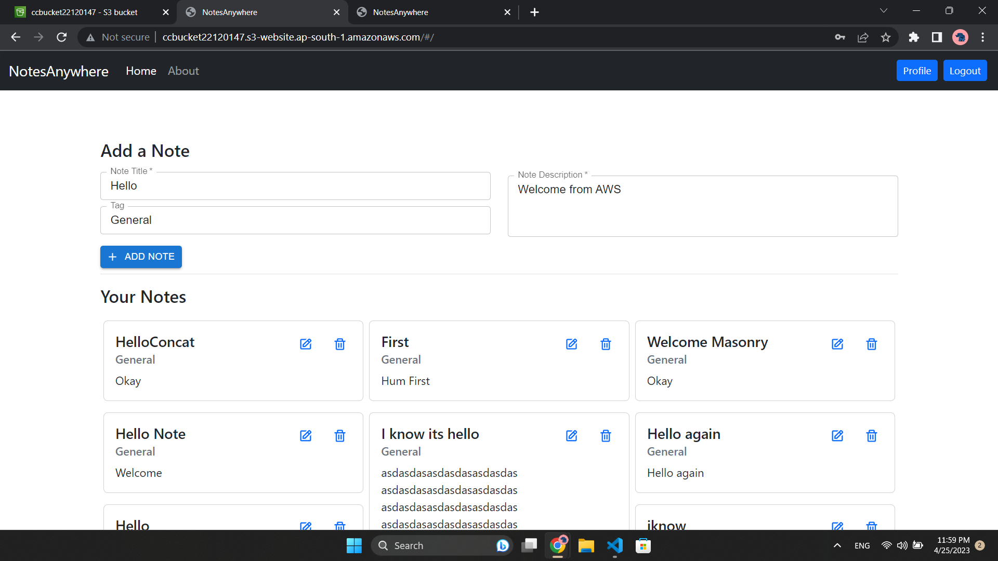
12. Deployment Successful
Use the S3 Bucket Static Public URL to access the hosted website
Your CI/CD Pipeline is working!
Visit to try: http://ccbucket22120147.s3-website.ap-south-1.amazonaws.com/

Slide 17

Thank -You

